Slide 1
Event Management system
Project Made by: Hassan-Uddin , Ammad Mobin And Nabeegh Yaqoob

Slide 2
ERD diagram
c_id
Tb_customer
tb_admin
adds
a_password
c_name
C_address
c_aid_fk
c_gender
c_email
a_id
a_name
create
Shows venue
Tb_event
e_cid_fk
Tb_venue
e_id
e_payment
v_id
e_name
e-capacity
e_loaction
e_type
v_name
v_eid_fk

Slide 3

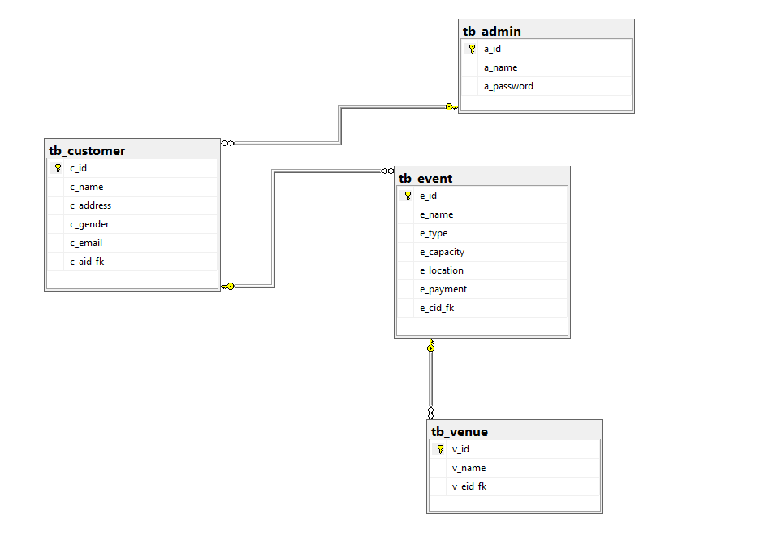
Relation Database Schema
This is the relation database diagram which tells which table is related.

Slide 4

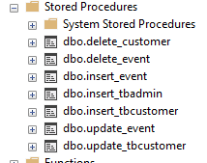
List of tables and Store Procedure used in our Database
We will used store procedure to encapsulate the SQL quarries and then use it in our application
Code Reusability: Stored procedures promote code reusability by allowing multiple parts of an application to execute the same set of SQL statements without duplicating the code. This reduces redundancy and makes maintenance easier.

Slide 5
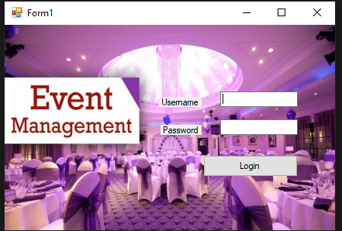
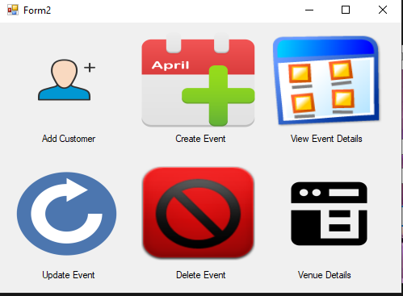
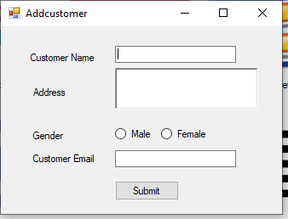
Forms used in our application
Login Form
Main Menu Form
Add Customer Form

Slide 6
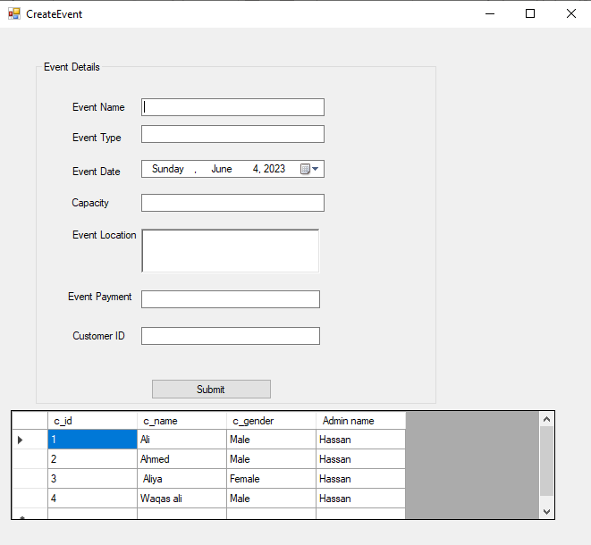
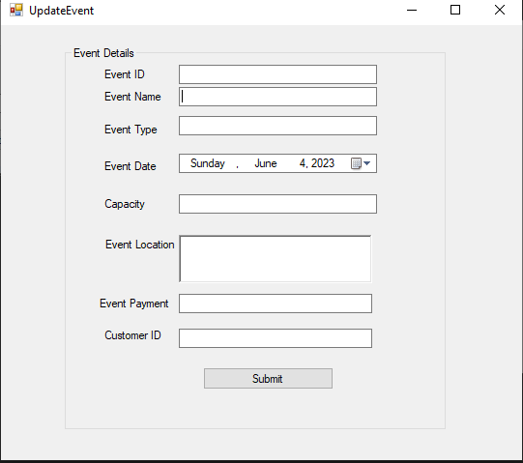
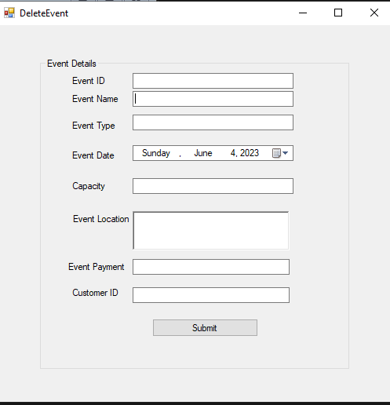
Forms Used
Create Event
Update Event
Delete Event

Slide 7
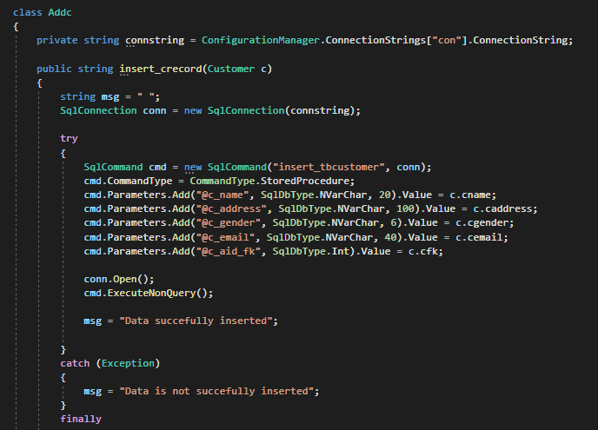
Insert Form Code and Procedure call
We used store procedure to call the insert query.
We passed the Colum name of the store procedures so that we can insert the data in the table.

Slide 8
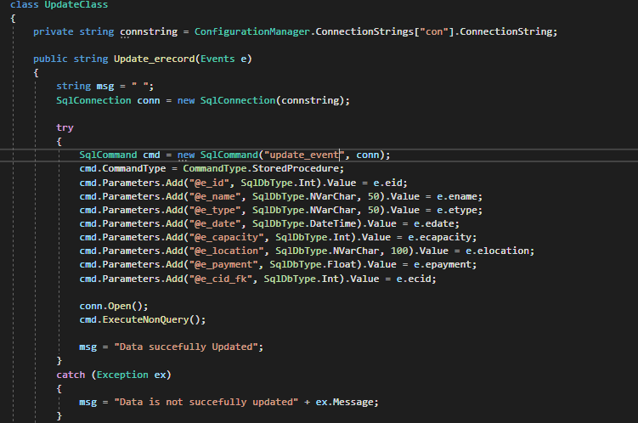
Update Code and procedure call
We passed the store procedure update_event in which the update query is saved and helps us update the table.

Slide 9
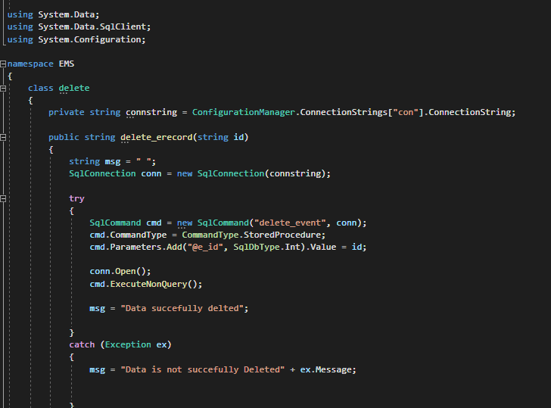
Delete Code and procedure Call
We passed the delete_event procedure to delete an event the delete query required an ID so it can delete the event completely from database.

Slide 10
Connection to Database
We used connection string tag to provide the path of our database which we require and than provide it a name and provider name. this helps us to connect our MS SQL .

Slide 11

Thank You

